Slide 1

iOS apps DEMO
Presentation of two iOS projects developed for learning purposes

Slide 2
Idea behind
Why two applications?
The goal was to learn different aspects of iOS development by building small applications that could teach distinct ways to work with the Swift programming language and the XCode platform. These are the longest ones of the four I have worked on so far, on iOS.
The first application does not focus on UI design as it has a simple interface. The target was working with the Twitter API , CoreML 2, Natural Language Processing and Machine Learning models.
On the other hand, the second application focuses on the UI design and fundamental iOS components such as Table View and on working with cloud-based backend database.

Slide 3
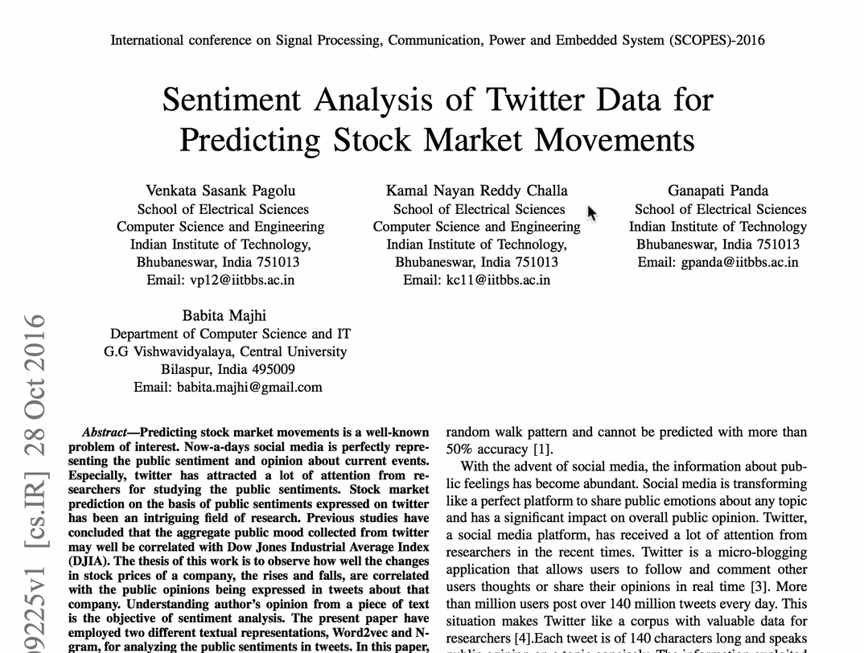
Idea behind the first application

Slide 4
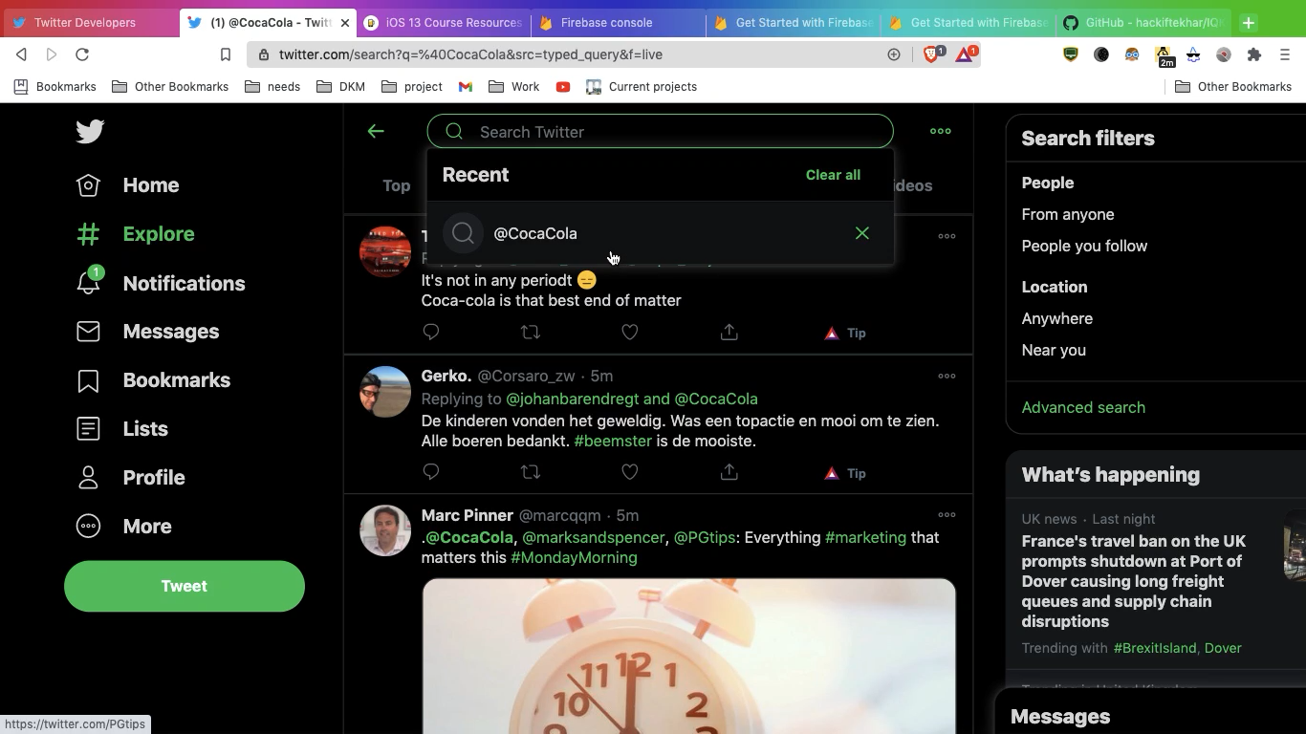

Slide 5
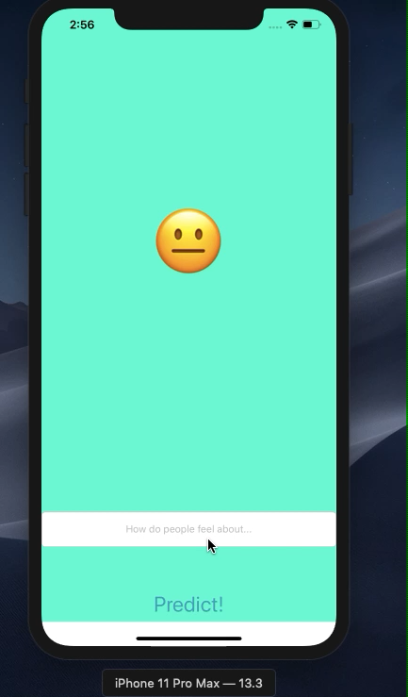
Twitter sentiment analysis
🡨 Play the video.
This app provides a simple user interface, but it is doing much heavy lifting all in the background using the powers of CoreML 2 and the Natural Language Processing

Slide 6
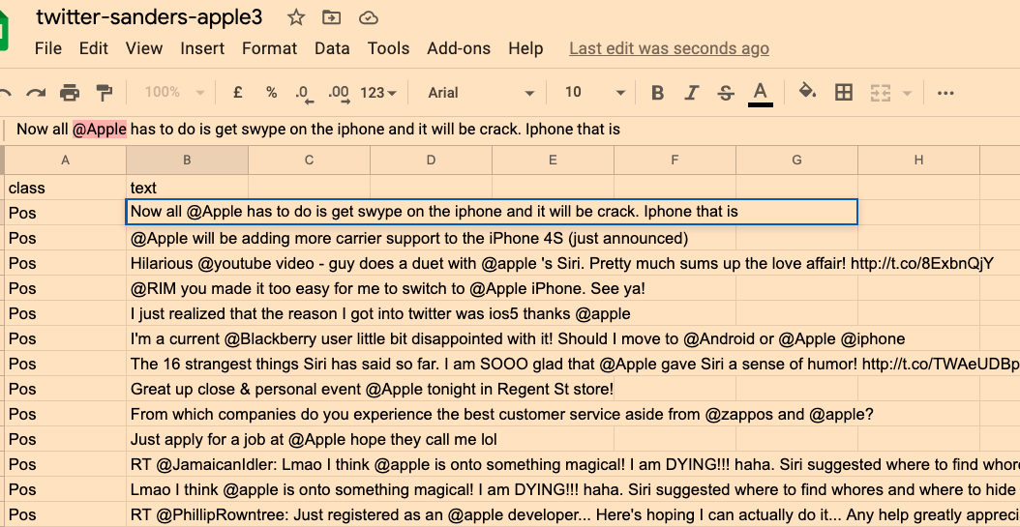
ML model for sentiment analysis
I downloaded a public dataset that comes from a company called Sanders Analysis which collected 1000 tweets that mentioned the AAPL (Apple stock) and they employed a bunch of humans to read through each of the tweets and give it a rating of positive, negative or neutral. These 1000 tweets were found by searching for the handle @Apple.

Slide 7
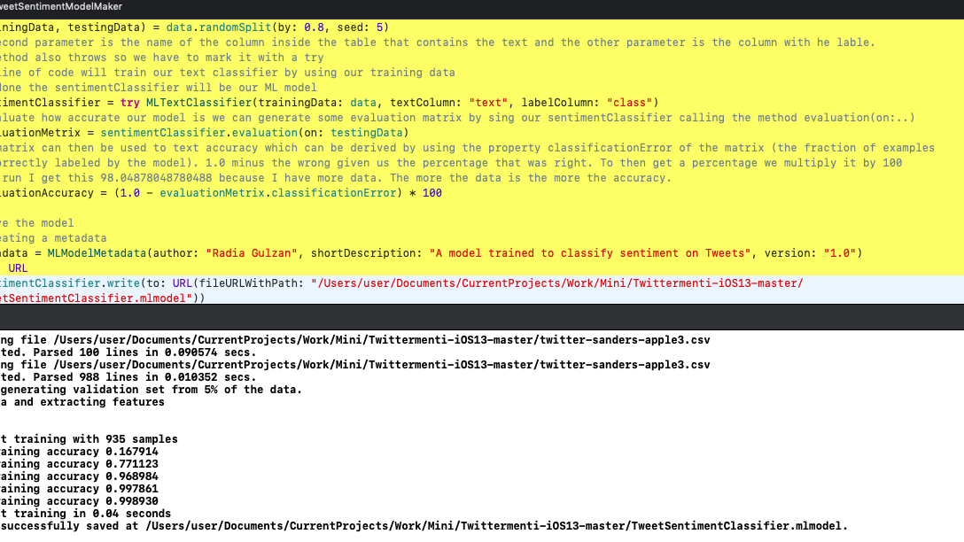
Creating ML MODEL
- opportunity to work with the MLDataTable from Create ML.
Opportunity to work with CSV files
Opportunity to work with MlTextClassifier
Opportunity to make an evaluation matrix
Opportunity to work with MLModelMetadata

Slide 8
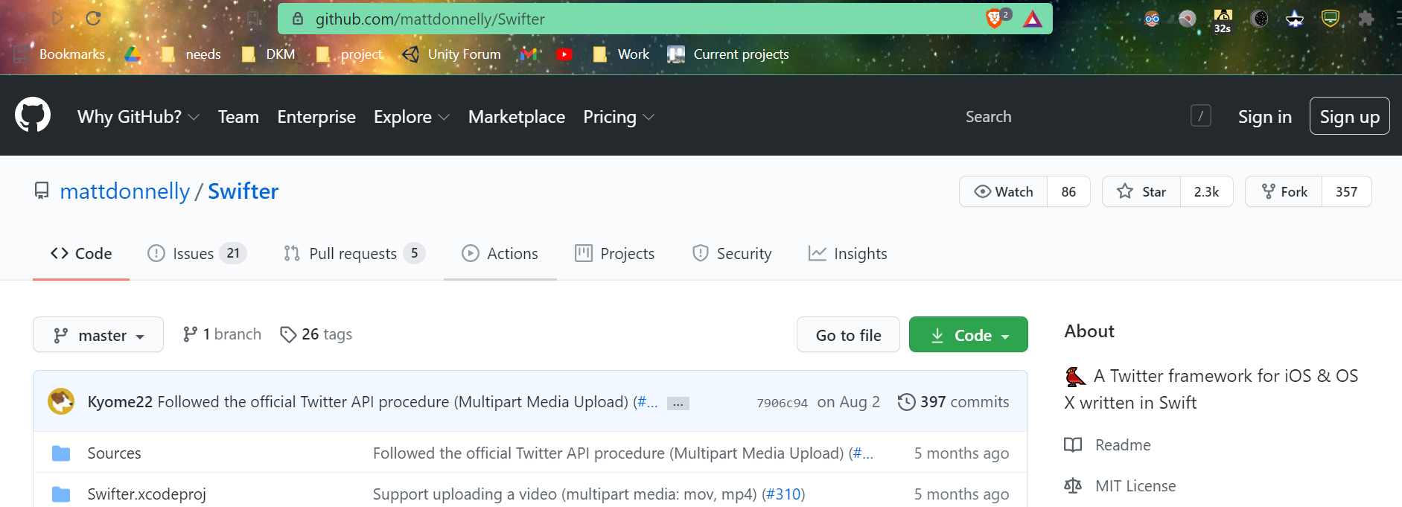
Once the NLP ML model that predicts sentiment from tweets was built, it has been incorporated into the app. I have used twitter API by using a third-party framework, called Swifter, a Twitter framework written in Swift.

Slide 9
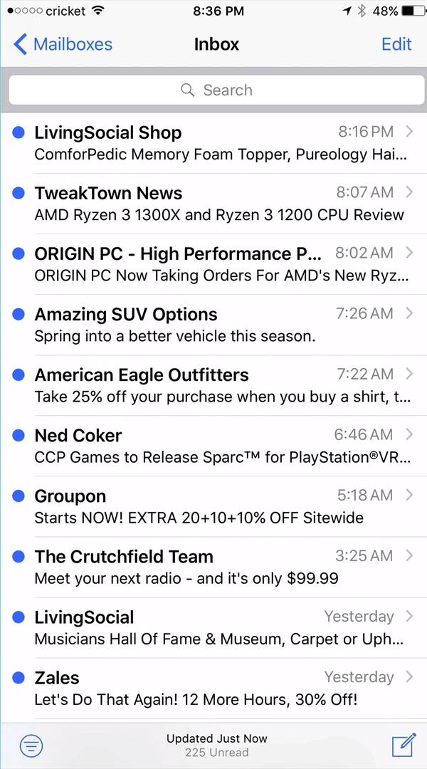
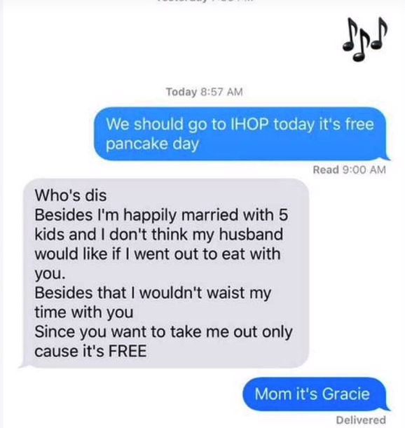
Idea behind the second application
Learning fundamental UI aspects such as Table Views

Slide 10
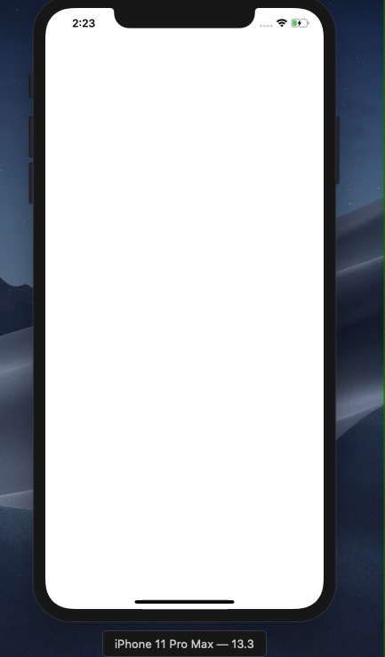
Chitter-Chatter
🡨 Play the video.
Chitter-Chatter was inspired by Flash Chat, an internet-based messaging app resembling WhatsApp. I have Firebase Firestore as a backend database to store and retrieve messages from the cloud.

Slide 11
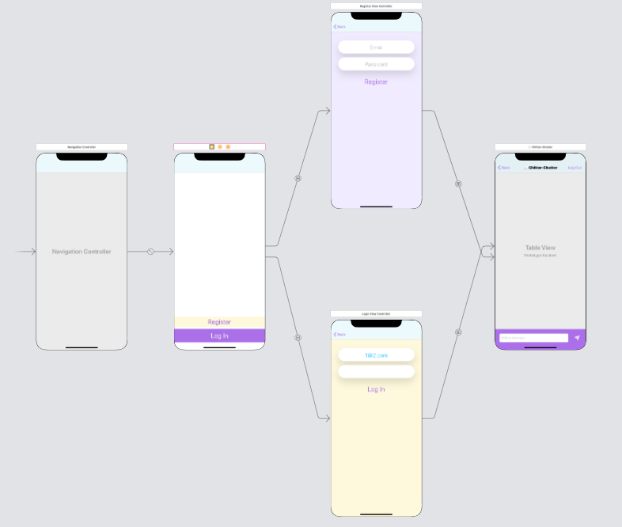
Main storyboard

Slide 12
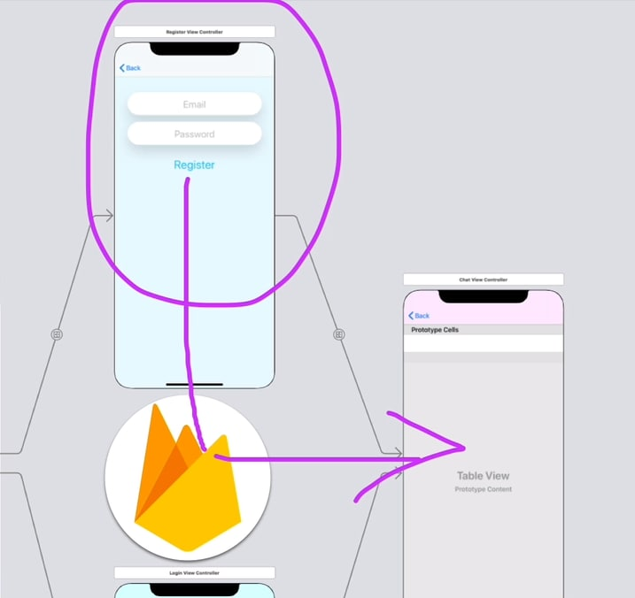
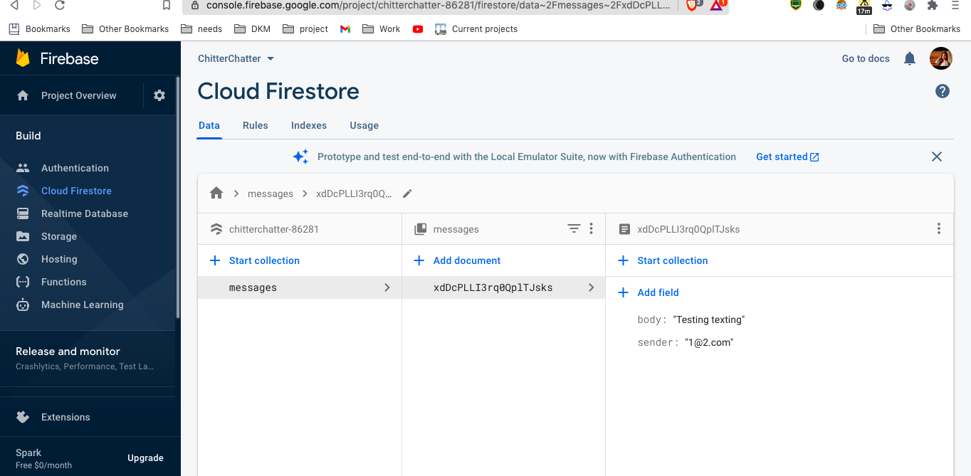
Things I have worked on
Integration of third party libraries with Cocoapods and Swift Package Manager.
Storage data in the cloud using Firebase Firestore.
Writing queries and sort the Firebase database.
Firebase for user authentication, registration and login.
UITableViews and how to set their data sources and delegates.
Creating custom views using .xib files to modify native design components.
View Controllers in a Navigation Controller and the navigation stack.
Creating a constants file and using static properties to store Strings and other constants.
Creating animations using loops.
App Lifecycle and how to use viewWillAppear or viewWillDisappear
Segues for navigation.

Slide 13
Next steps in preparation of the prototype development
Working on more iOS applications to sharpen the skills just apprehended
Practicing programming with Swift to learn better aspects such as closures
Revising Python
Researching on ML and NLP

